Slide 1




(21CC505PC) SOFTWARE ENGINEERING LAB
UPPAL CAMPUS
NARAYANGUDA
IBRAHIMPATNAM
LAB EXERCISE - 6
CONTINUOUS INTEGRATION TOOLS
TOPIC -1
BUILDING THE CI/CD FREESTYLE PIPELINE USING JENKINS FOR MAVEN JAVA PROJECT
BY
B MADHURIKA(Ph.D.)
Assistant Professor
CSE

Slide 2

SOFTWARE ENGINEERING LAB
(21CC505PC)
BY
MADHURIKA BUDARAJU(Ph.D.)
ASSISTANT PROFESSOR
CSE
KMIT

Slide 3
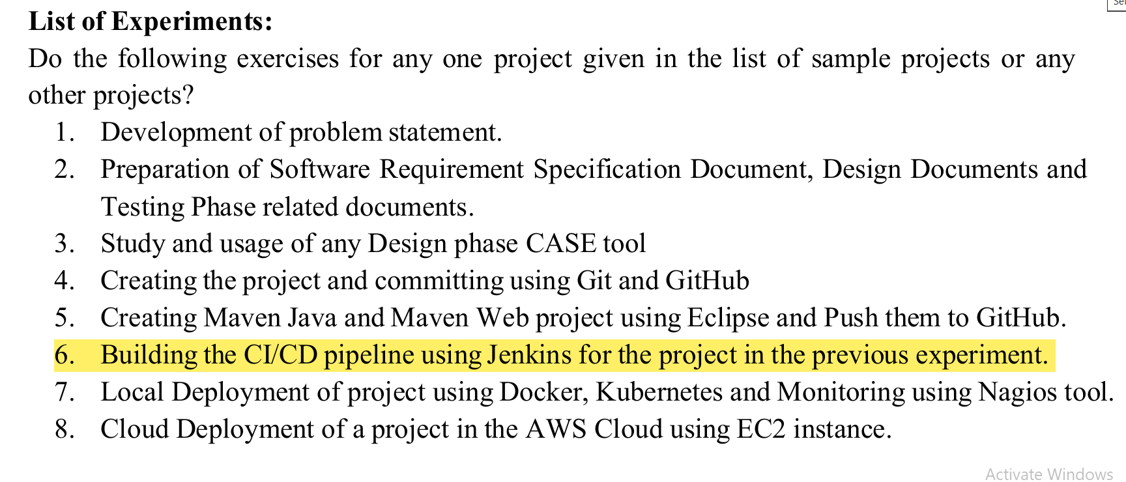

Slide 4
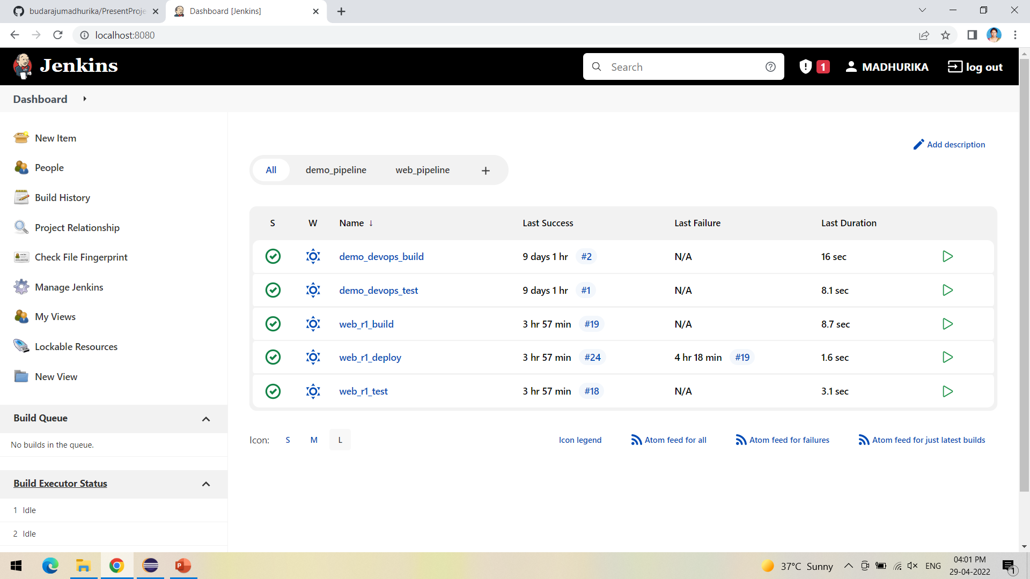
Open Jenkins in local host:8080 and create a new item

Slide 5
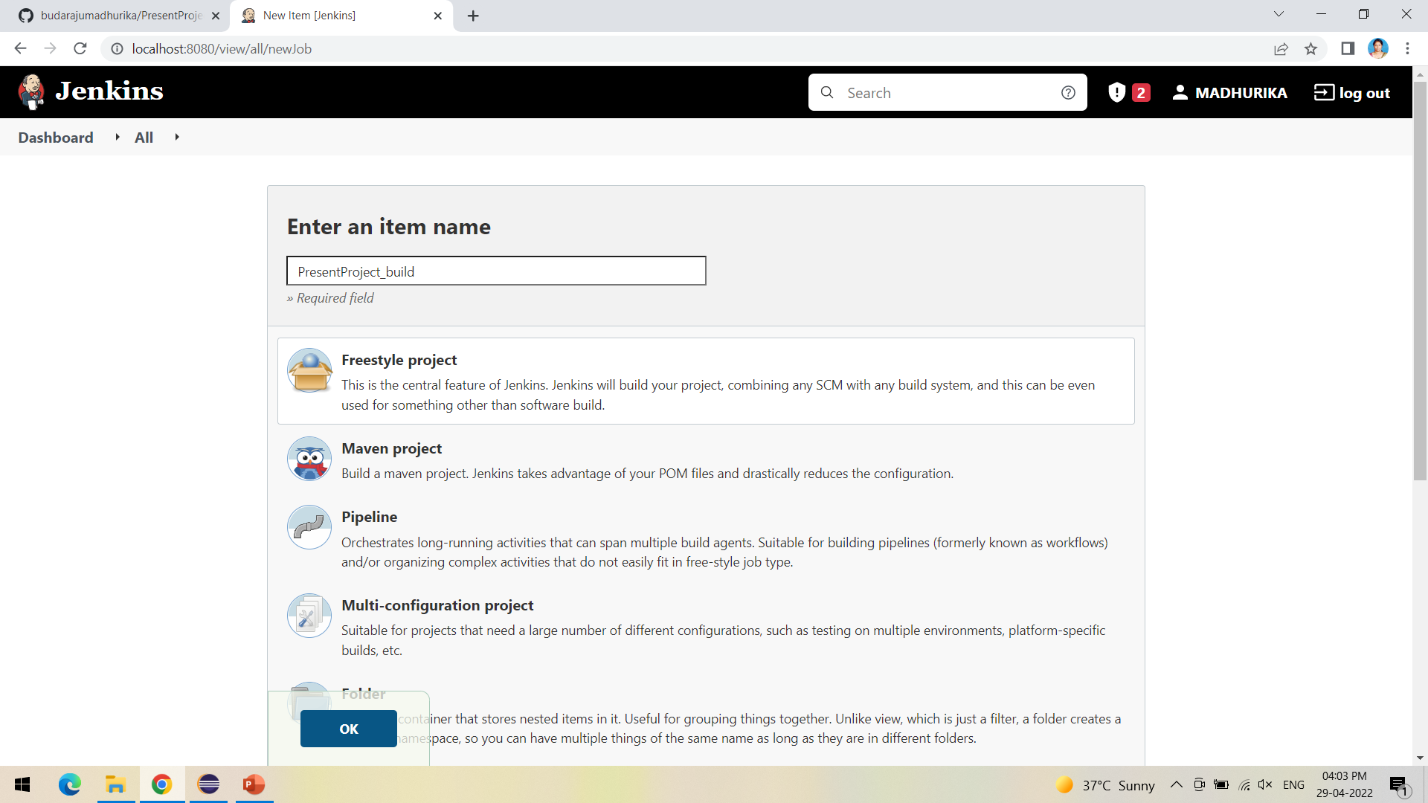
Create a new Freestyle Project and click ok

Slide 6
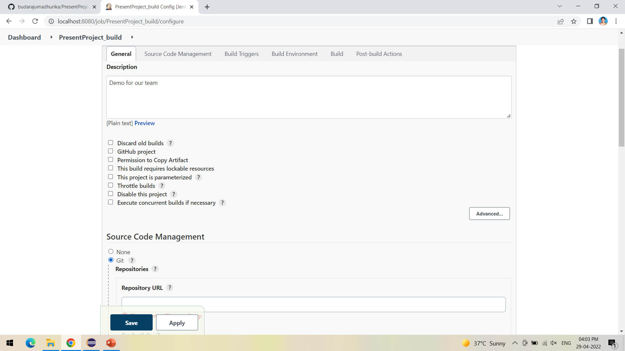
The next step is to give the Git repository URL of the project to be built

Slide 7
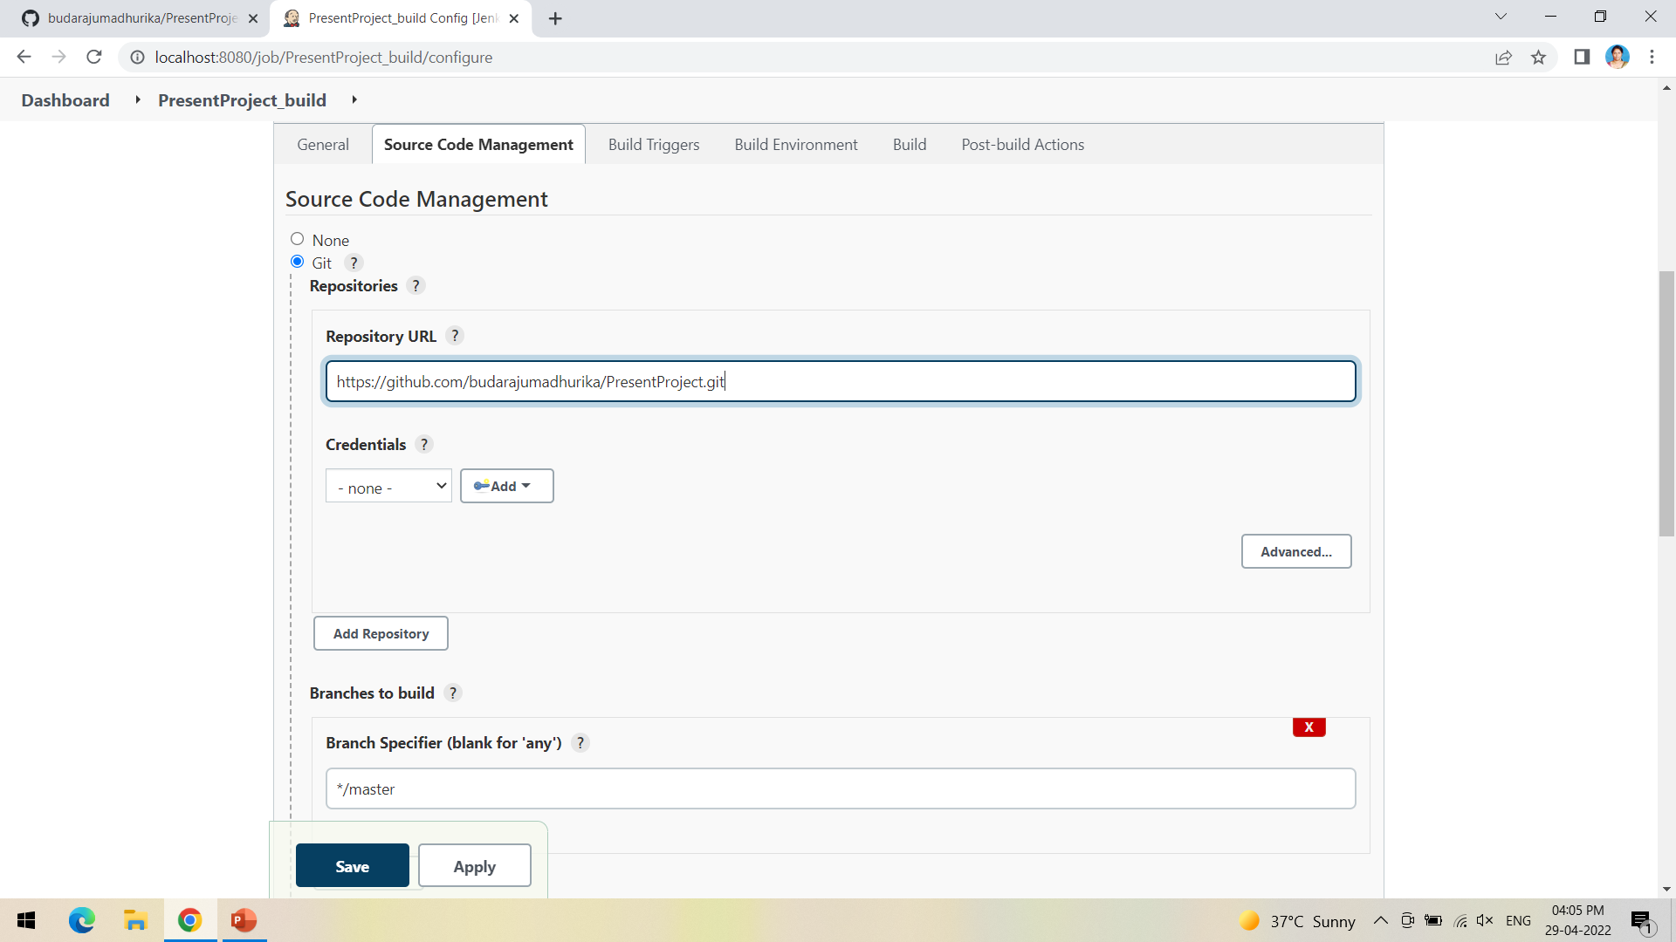
After adding the repository URL, Specify the Branch as either Master/Main as it is in the GitHub

Slide 8
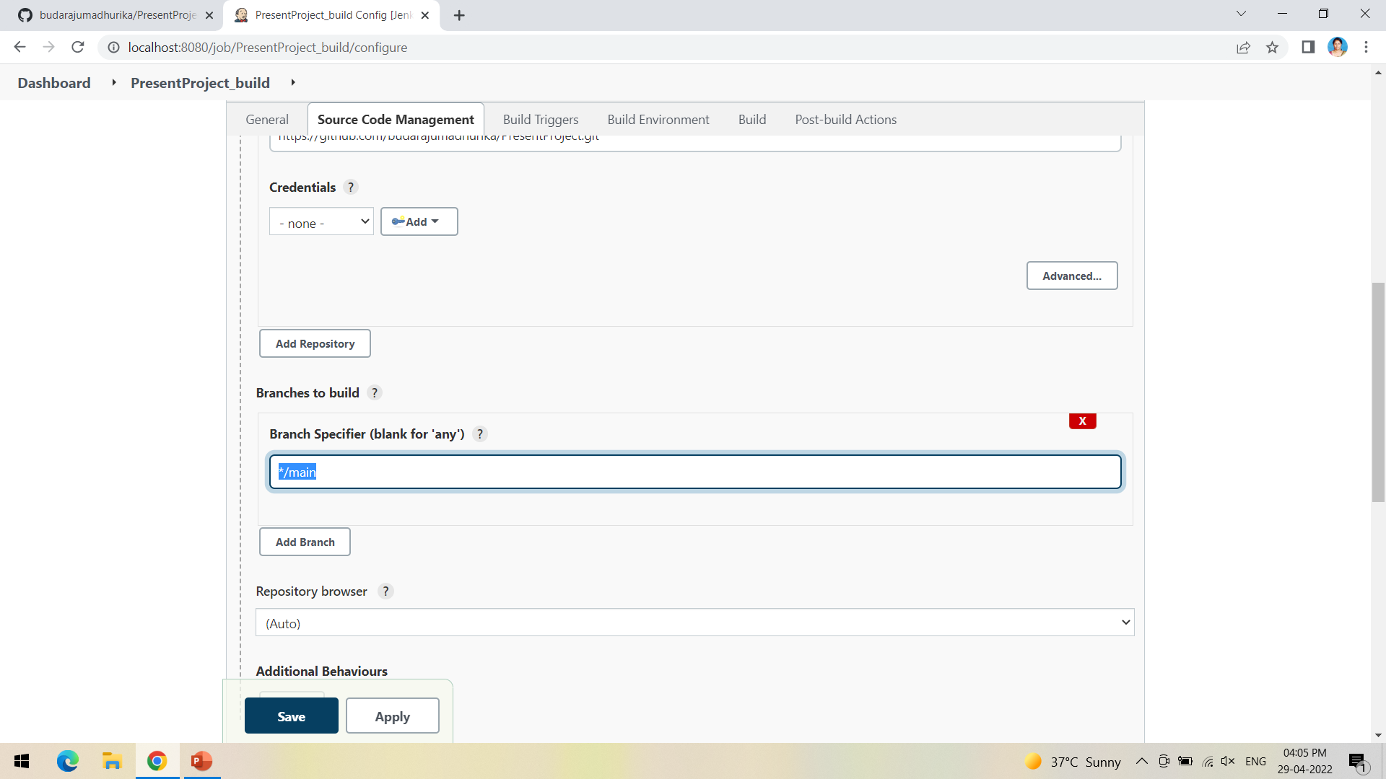
My project is in main branch so I have mentioned main

Slide 9
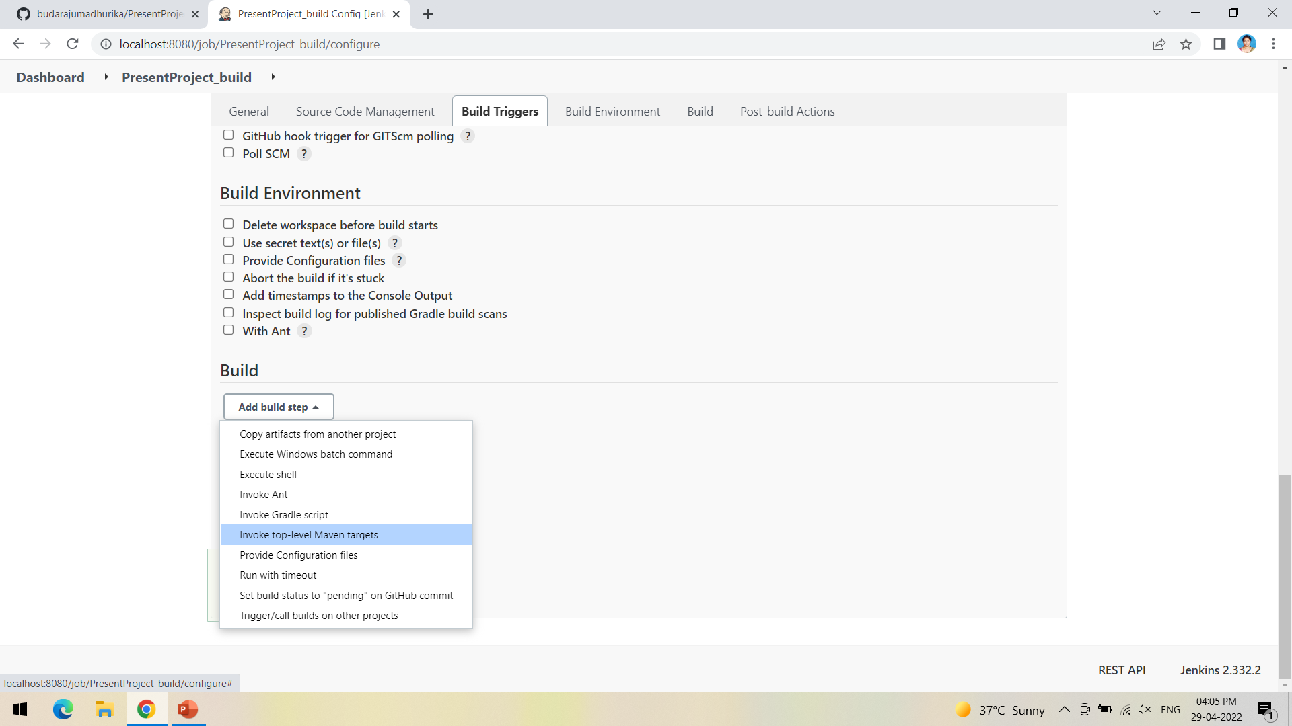
Now in Build, Invoke top-level Maven targets

Slide 10
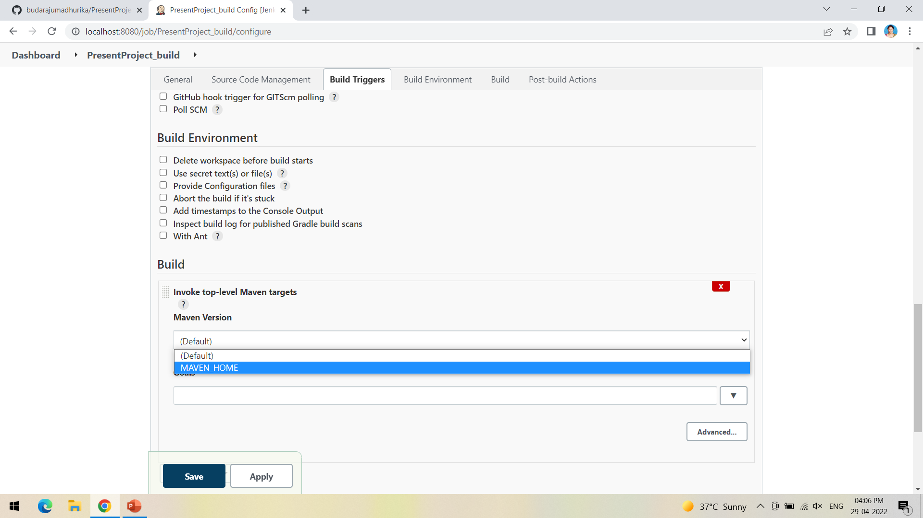
Select the Maven path which is already set in the global credentials in Manage Jenkins

Slide 11
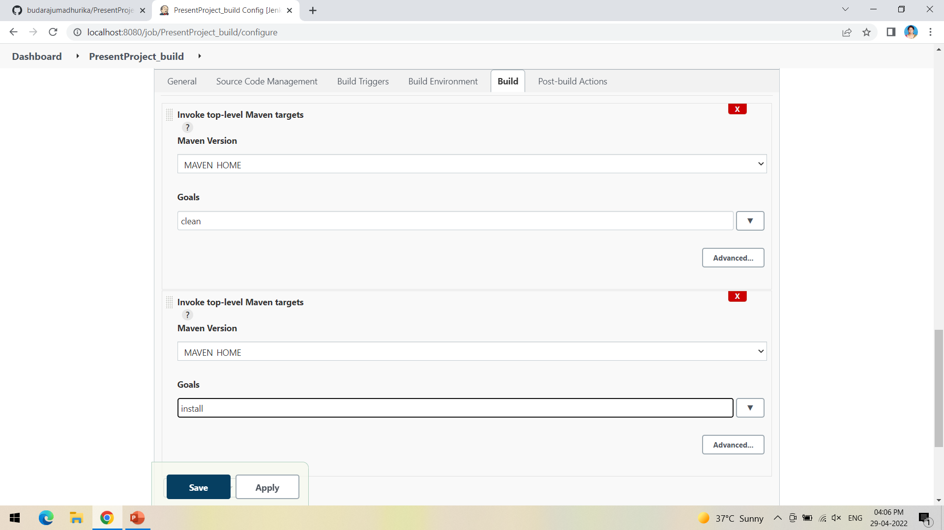
Follow the same goals as done in eclipse starting with clean and install

Slide 12
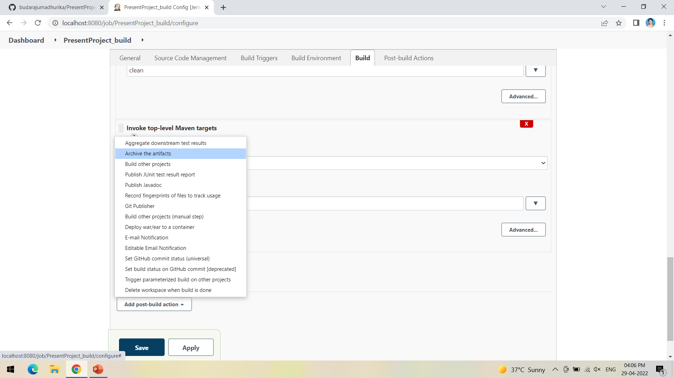
Now in post build actions-> select Archive the artifacts, to send the output of build project to the testing team

Slide 13
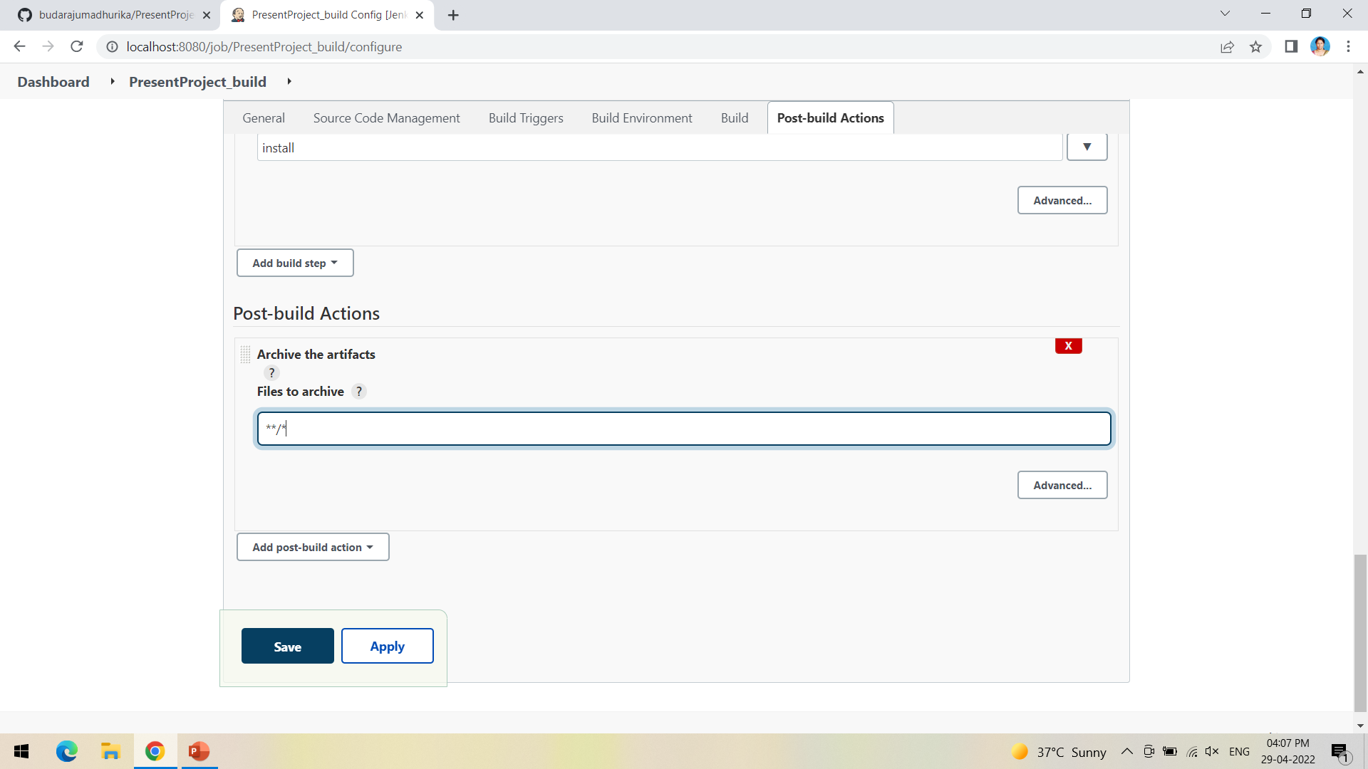
If we want to archive all the artifacts type **/* as shown

Slide 14
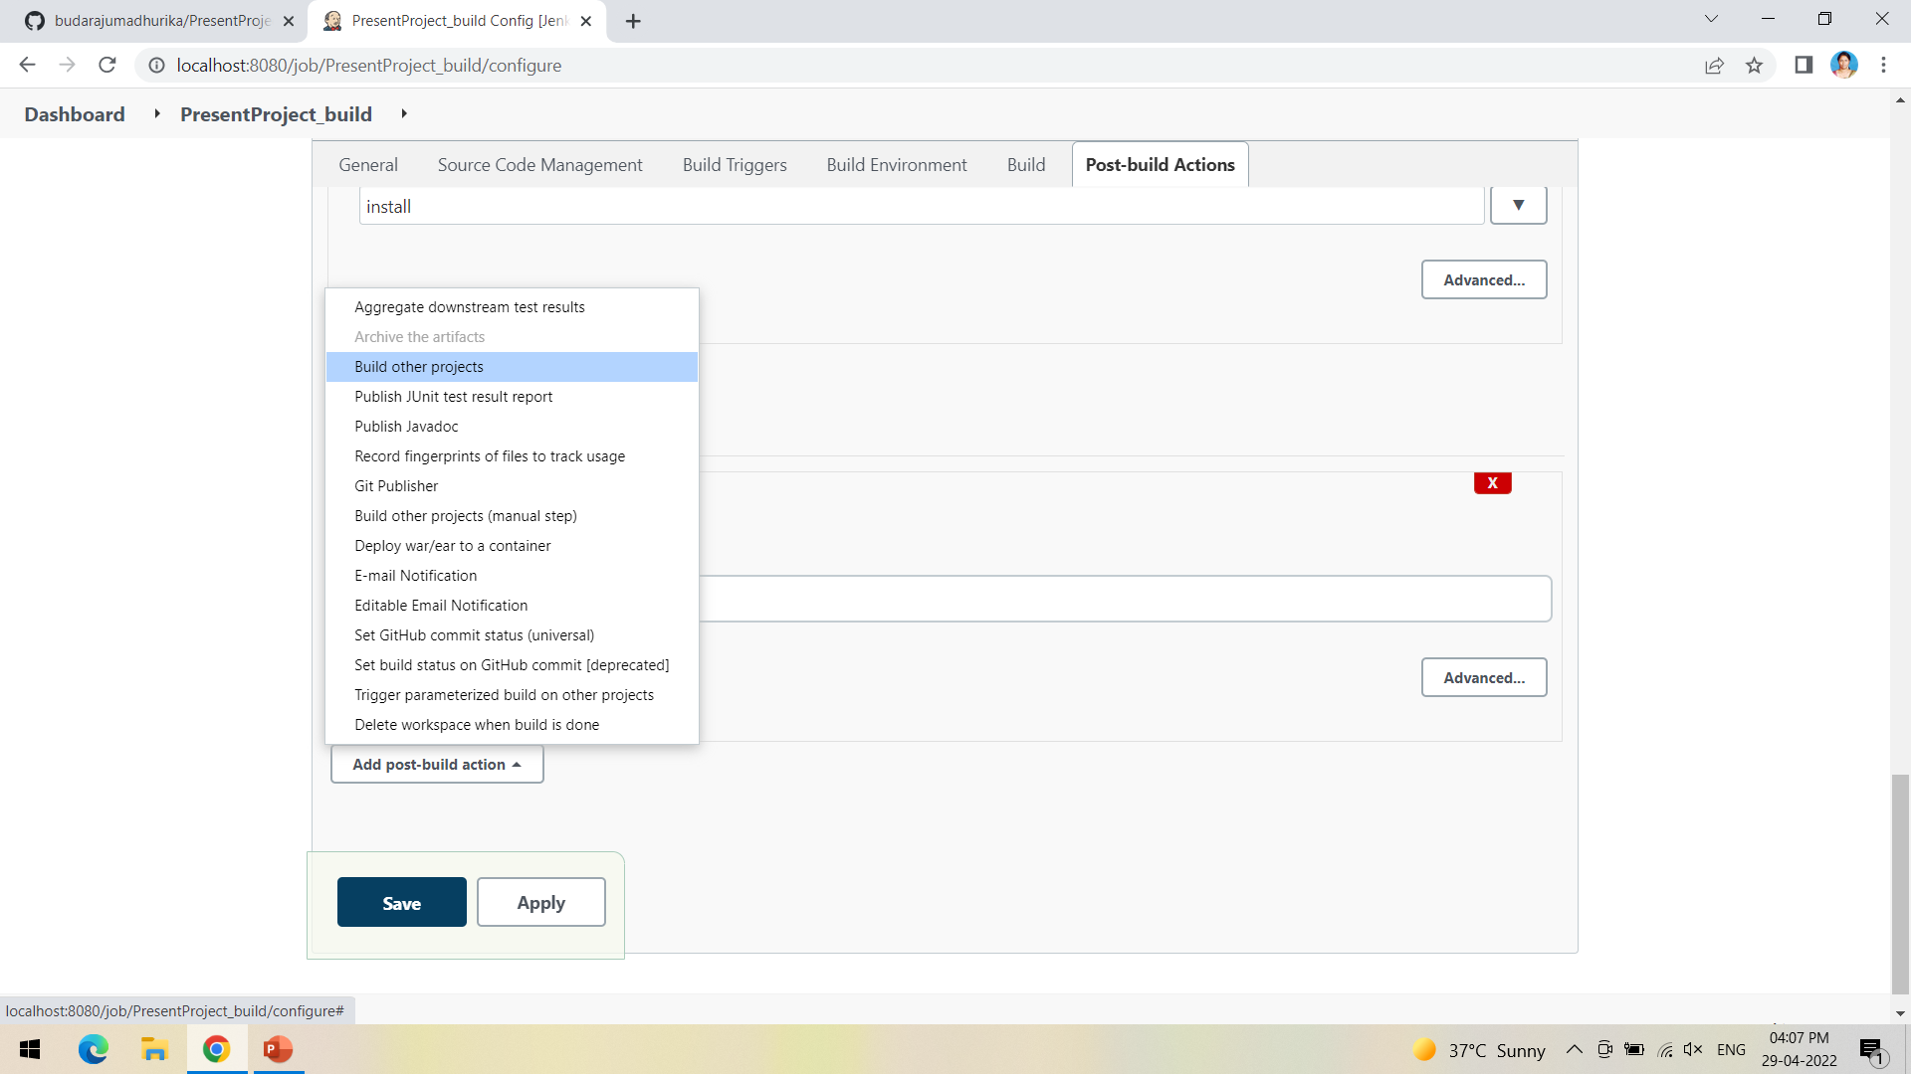
Now the next step is to build other projects, where we will create a test project which will be triggered by the build project

Slide 15
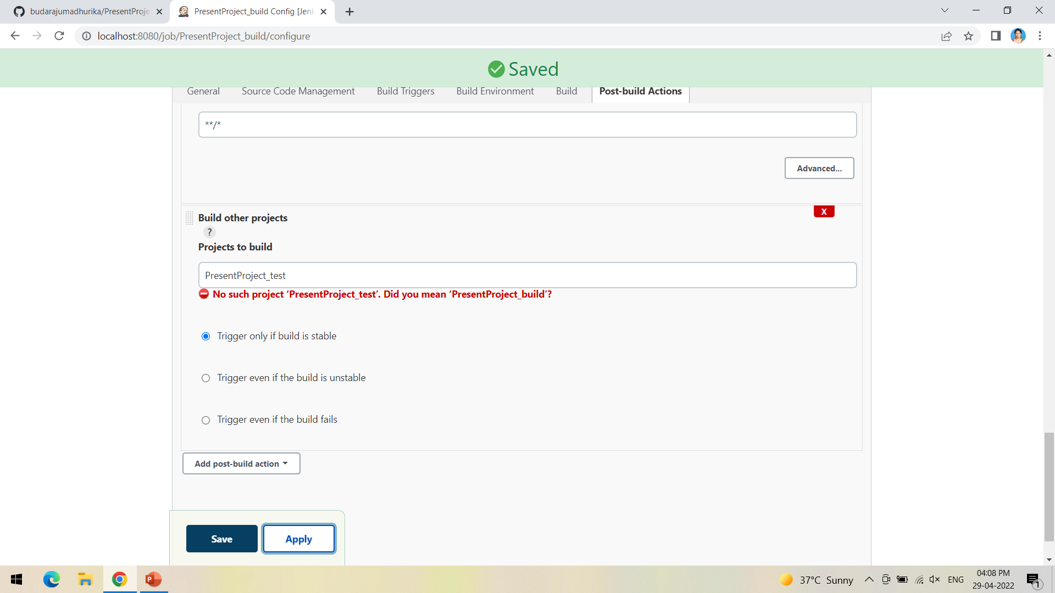
Ignore the red warning, as we have not yet created the test project

Slide 16
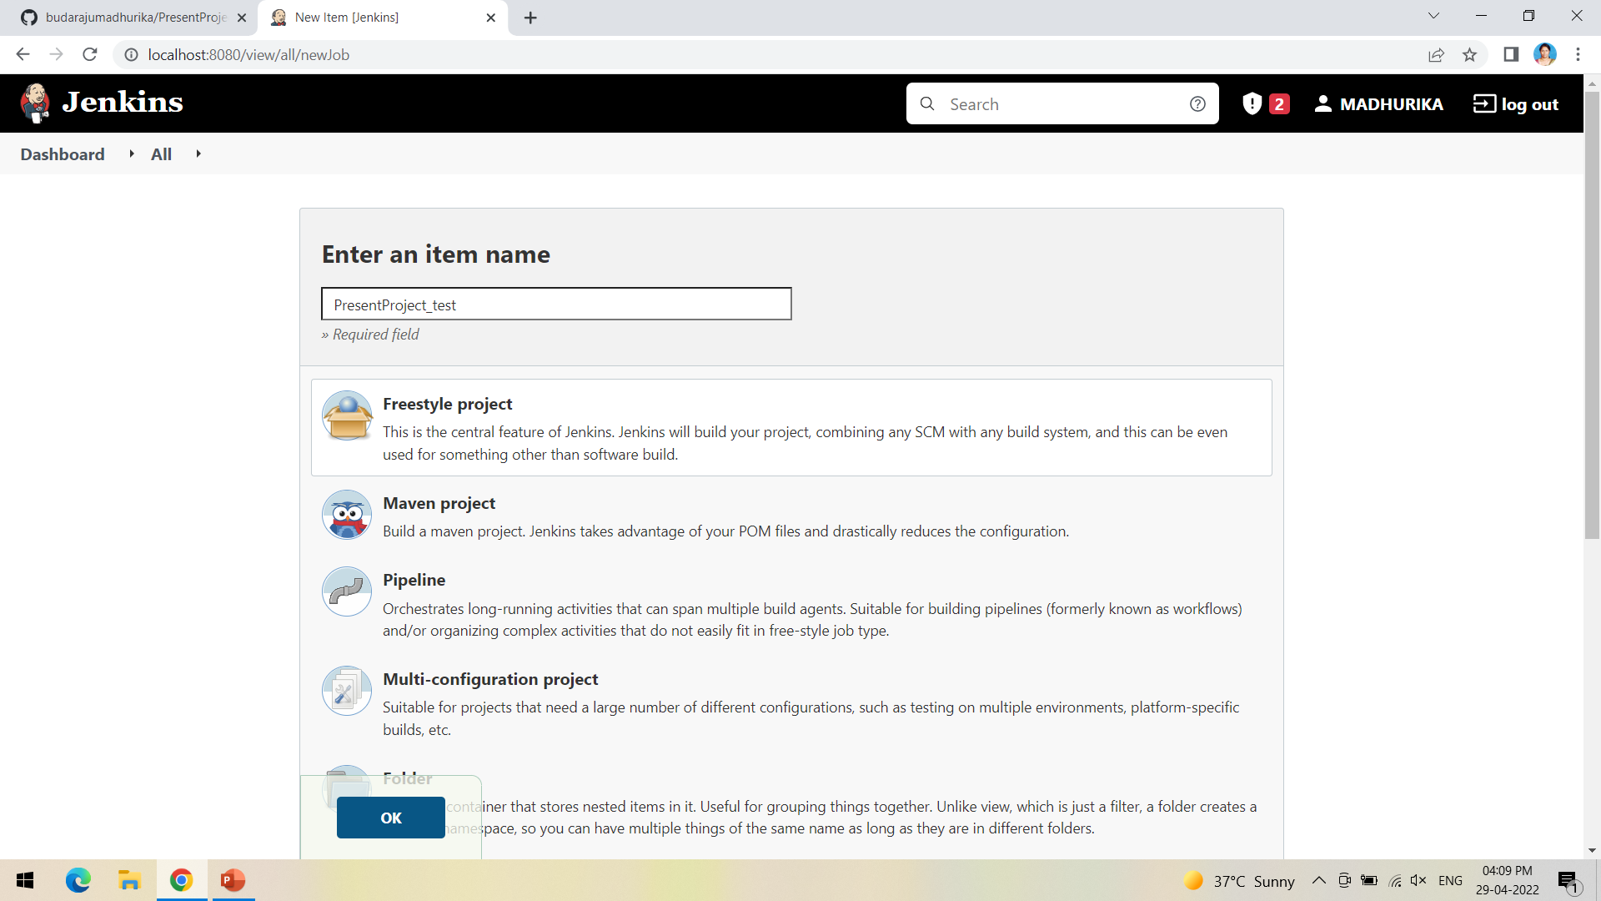
Create a new freestyle project test as shown and click ok

Slide 17
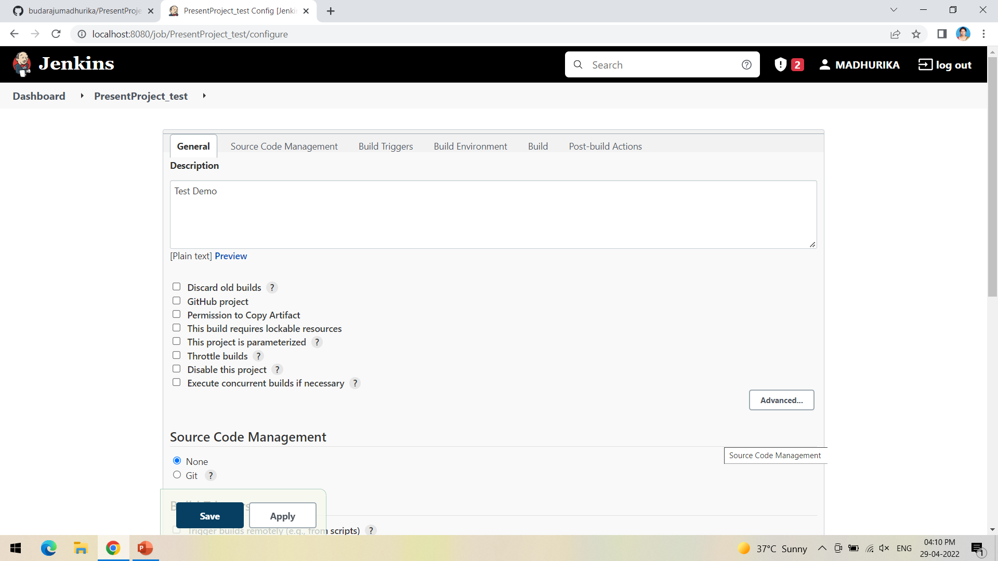
This time we need not mention the git repository so select None

Slide 18
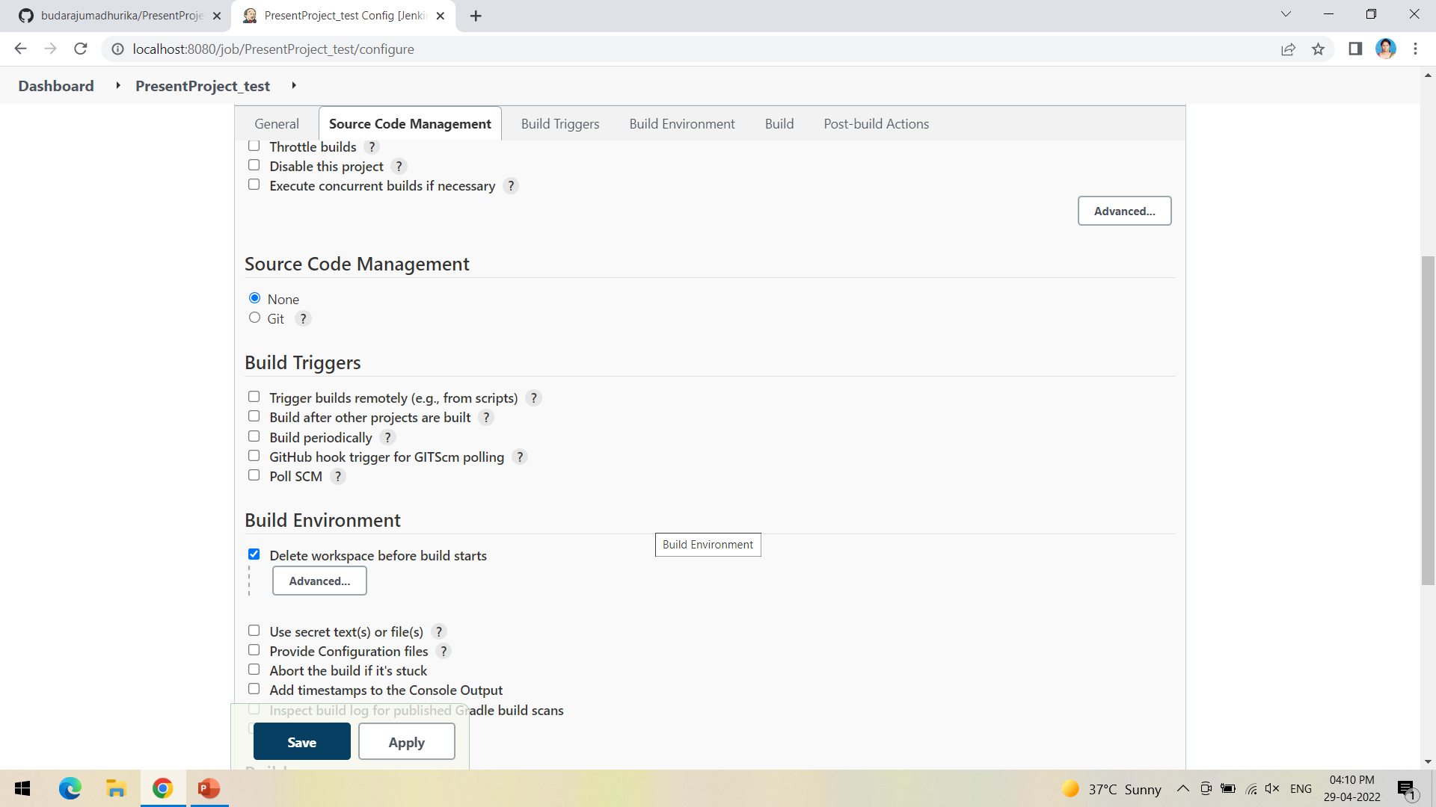
In Build environment check the box as shown below, this is to discard old builds

Slide 19
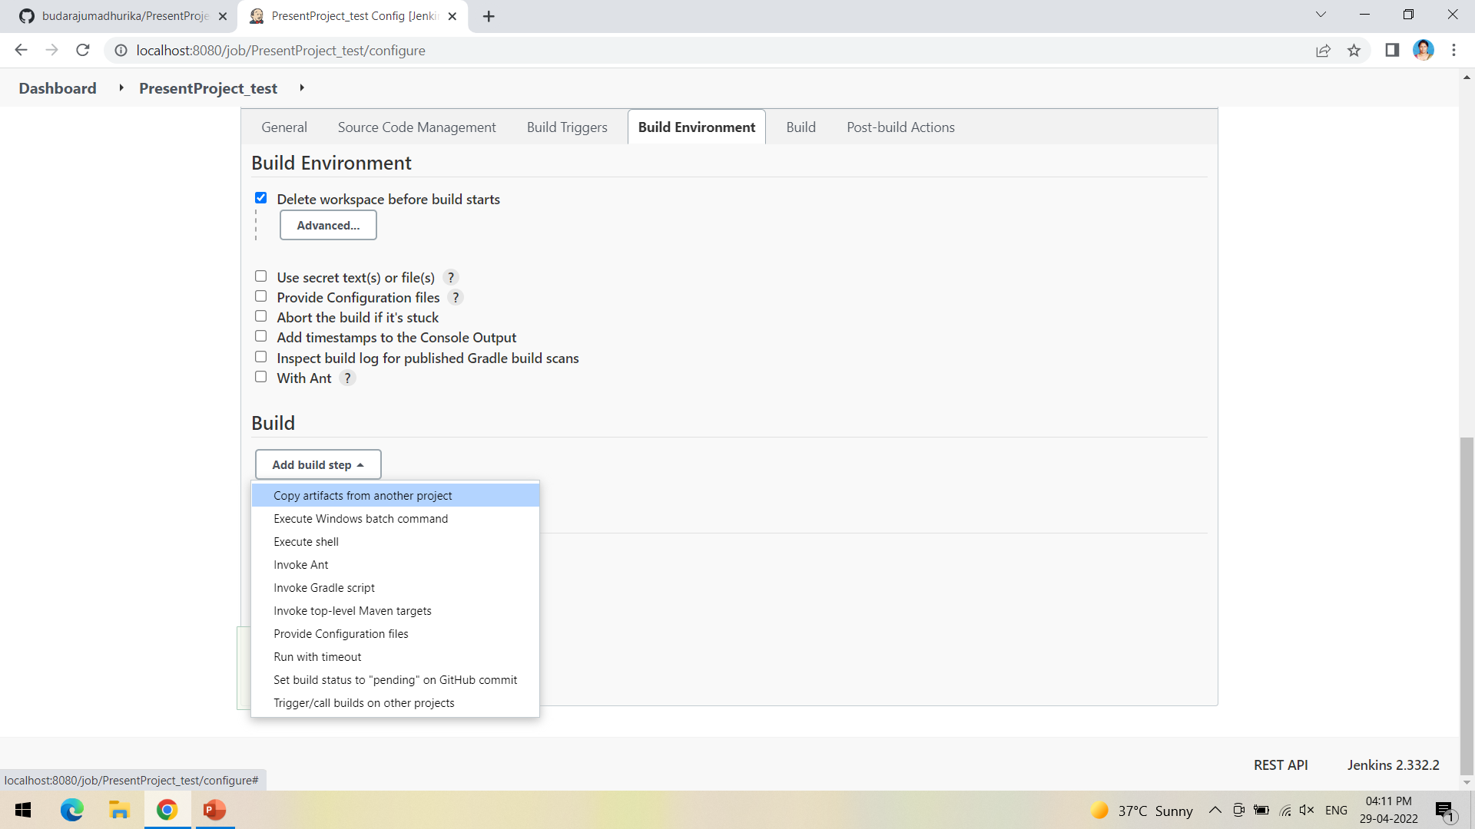
To forward the artifacts of the previous project to the current test project, select copy the artifacts from another project in Build as shown

Slide 20
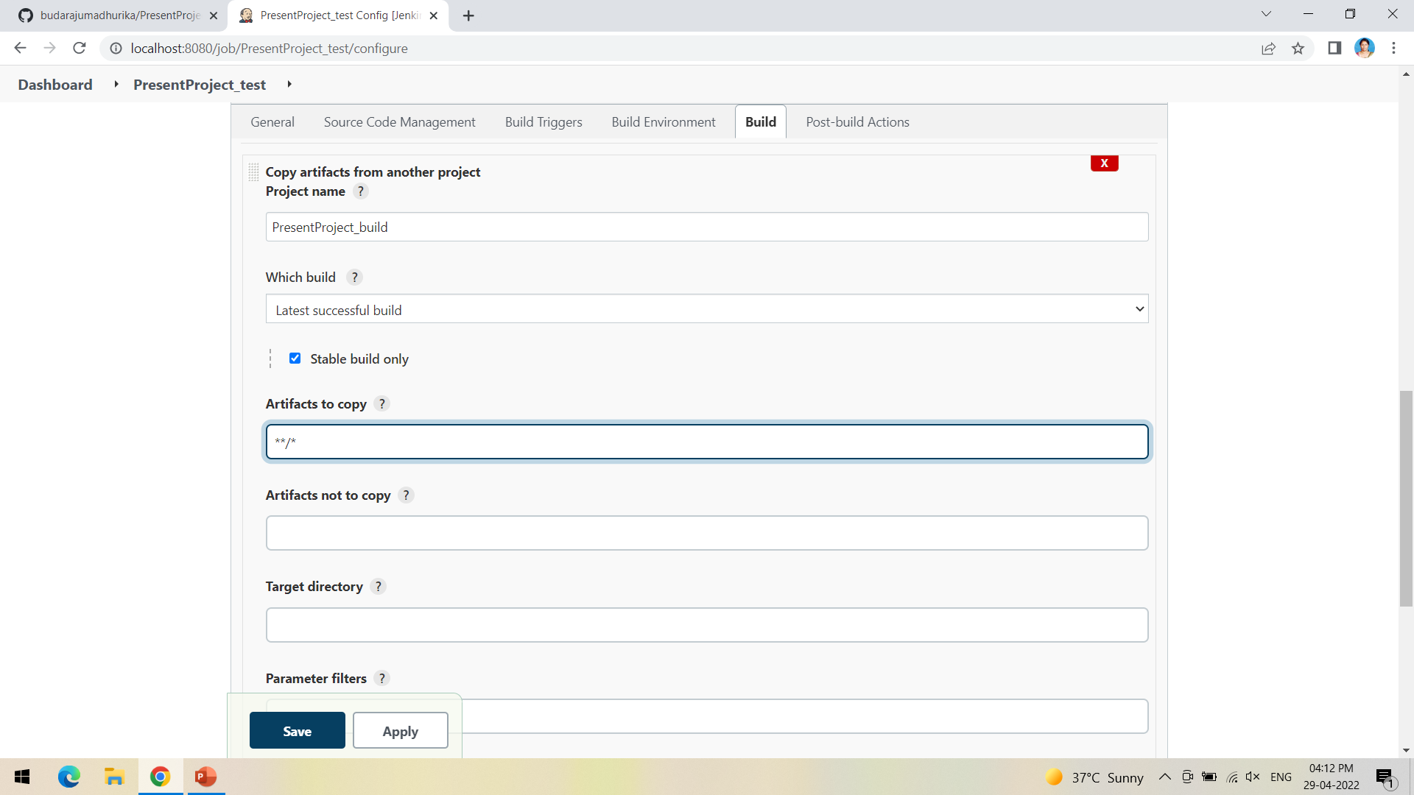
Give the name of the project from which we want to copy the artifacts and check the box ->stable build only->to copy all the artifacts type **/*

Slide 21
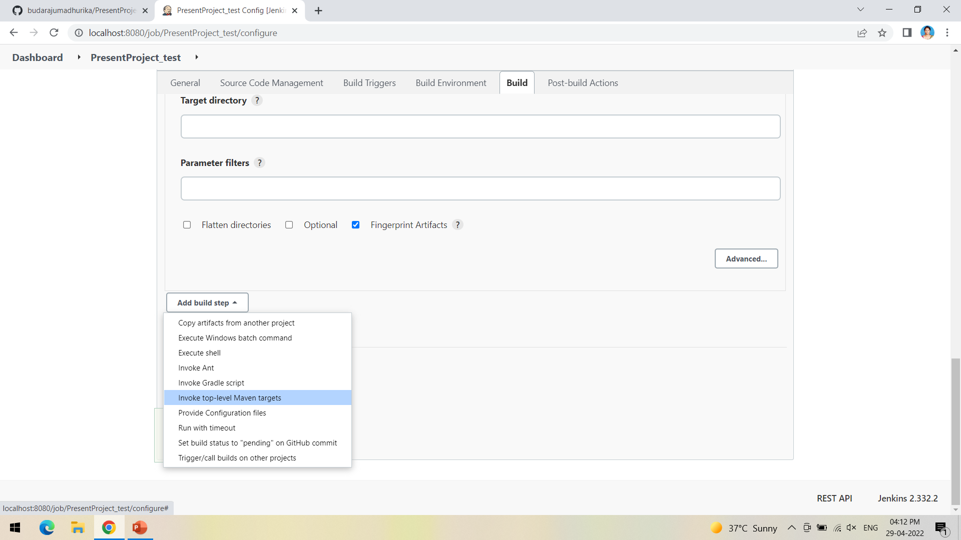
Now select Invoke top-level Maven targets in build

Slide 22
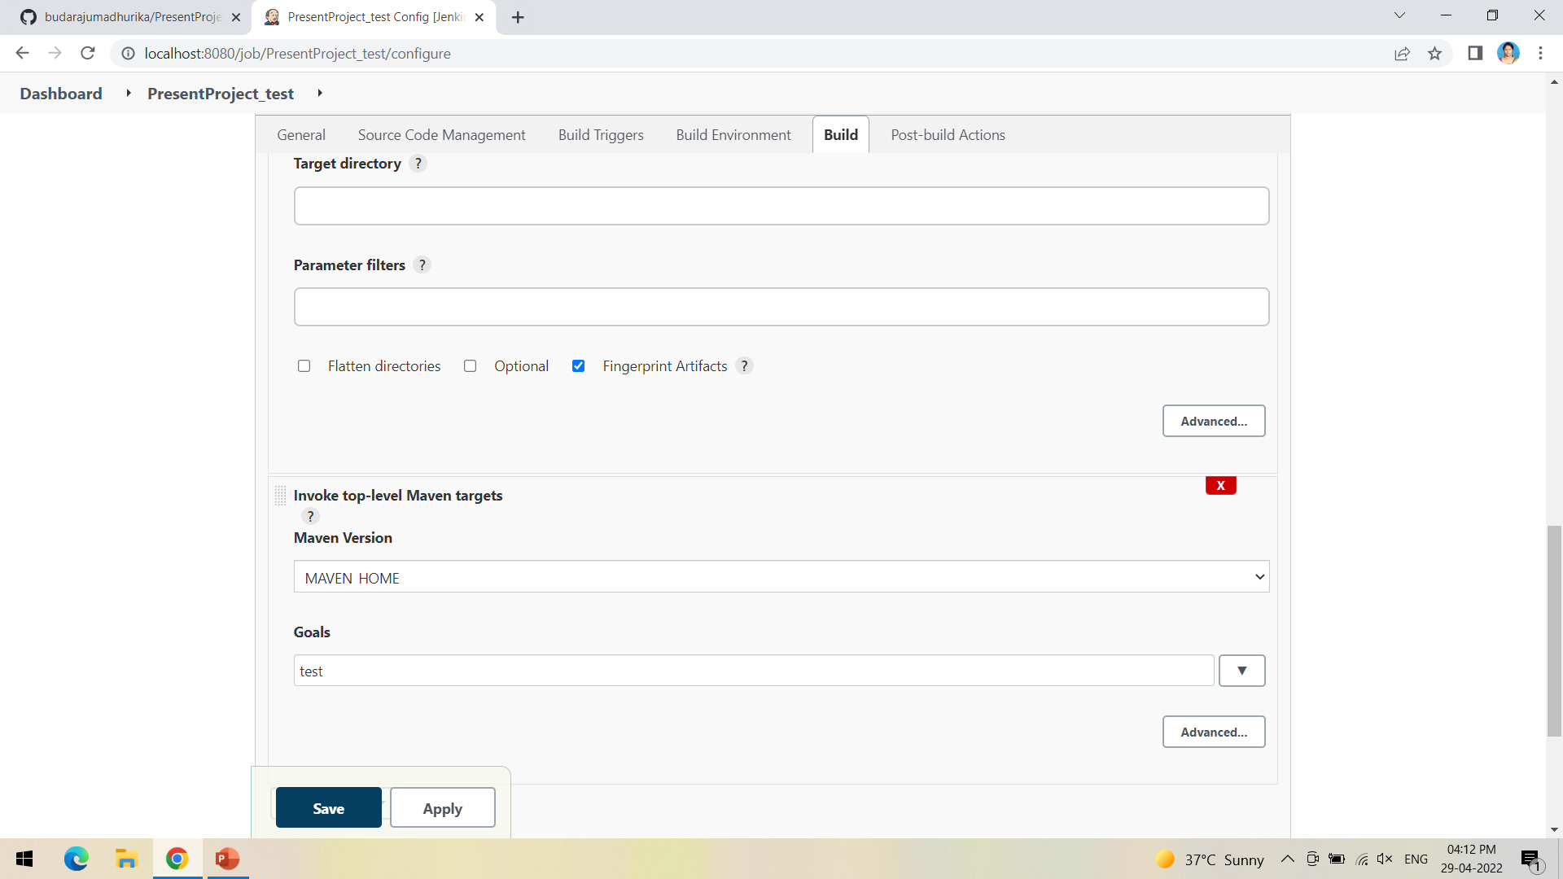
This time give the goal as test after selecting the Maven version

Slide 23
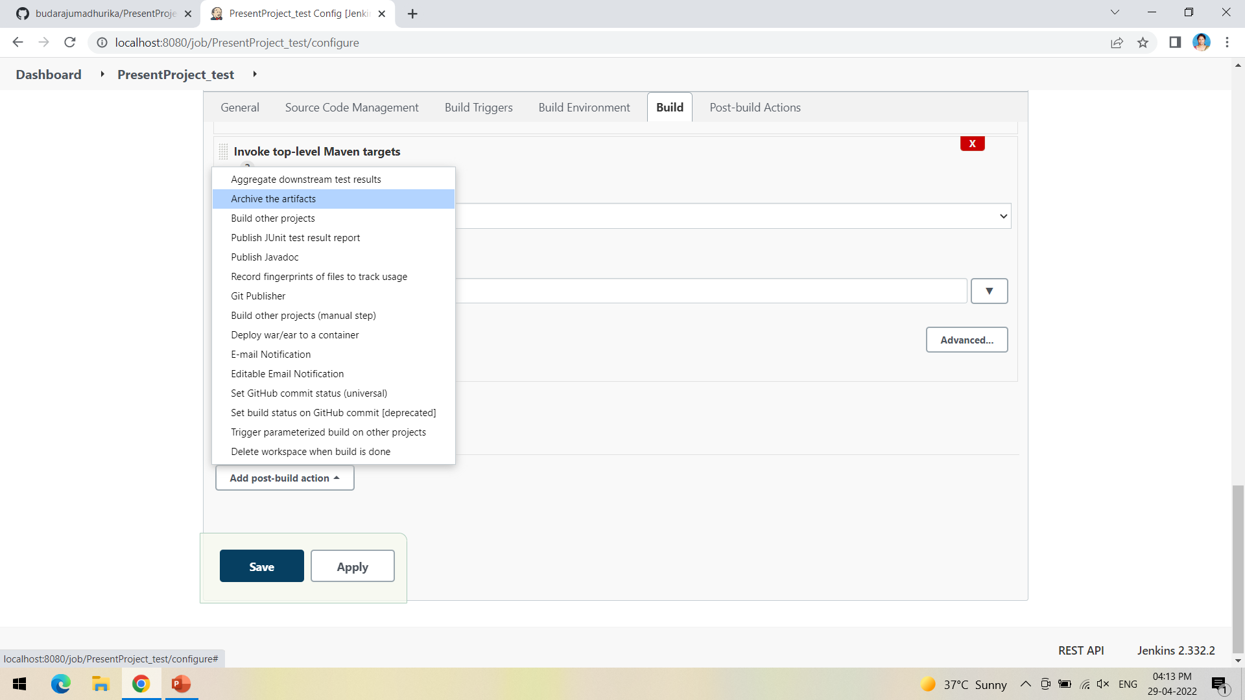
In post-build actions->select Archive the artifacts

Slide 24
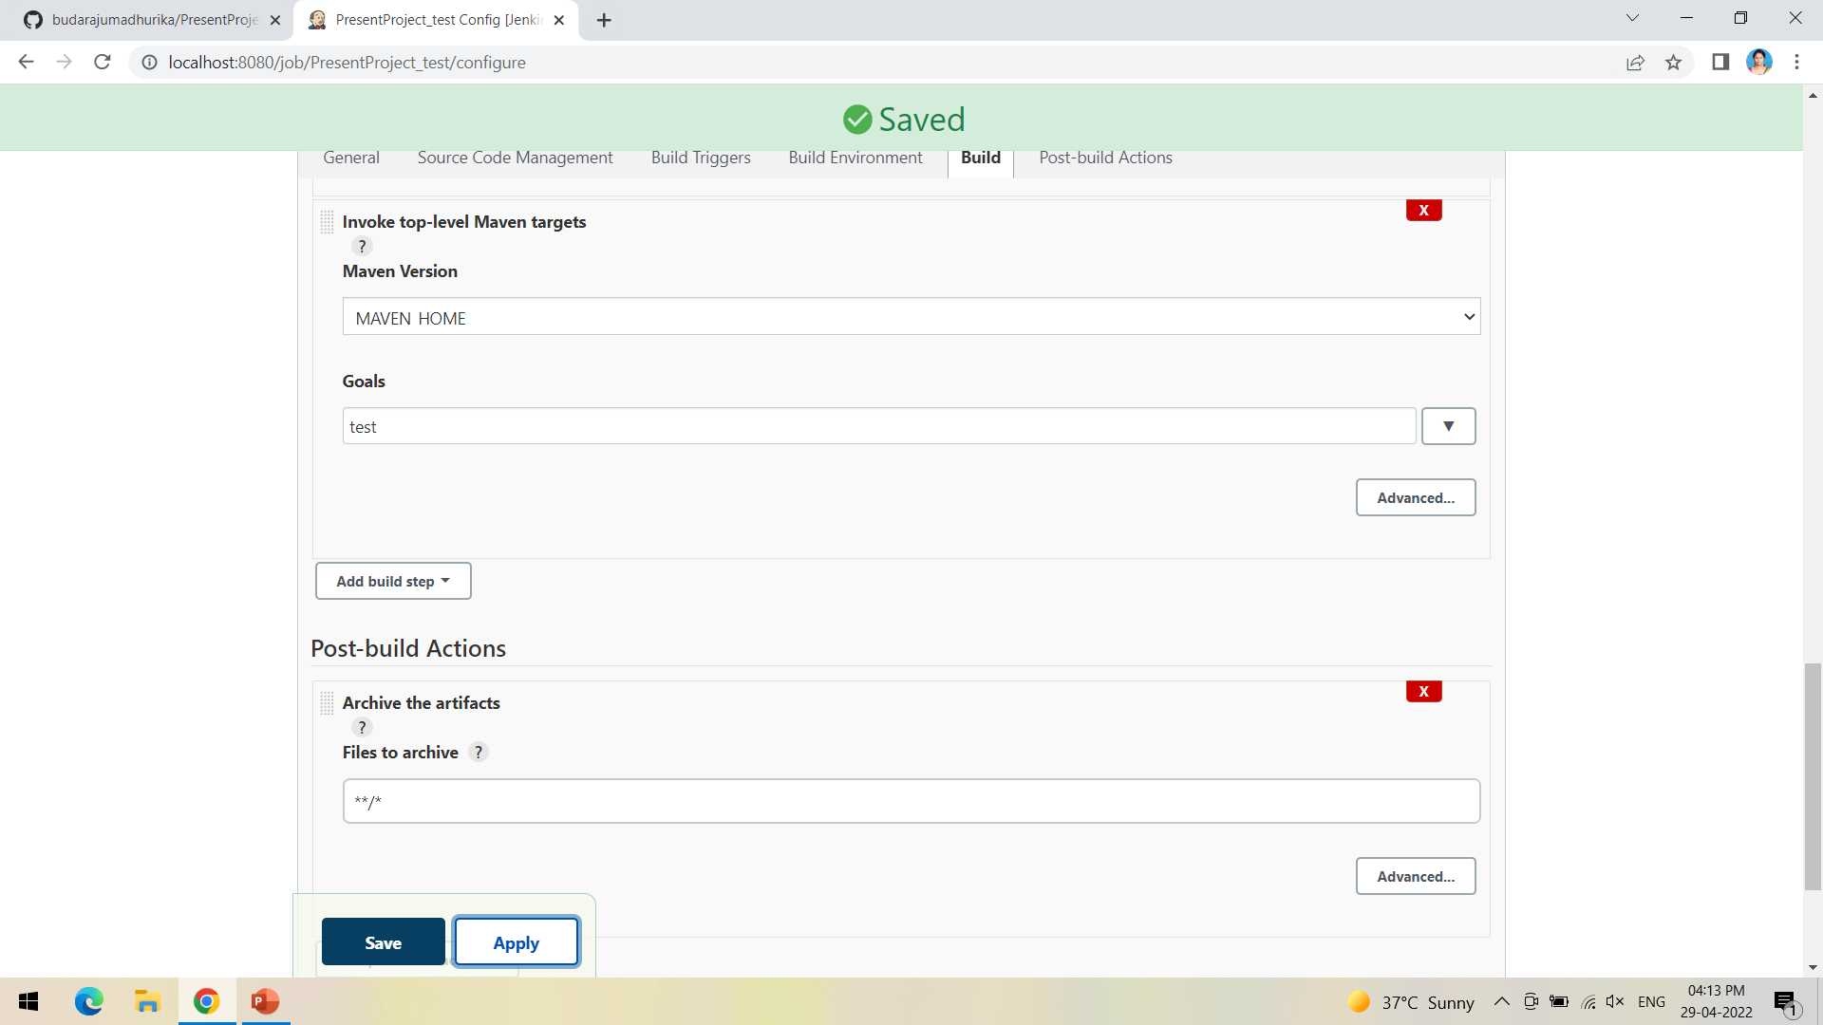
To save all the artifacts->type **/* and Apply->Save

Slide 25
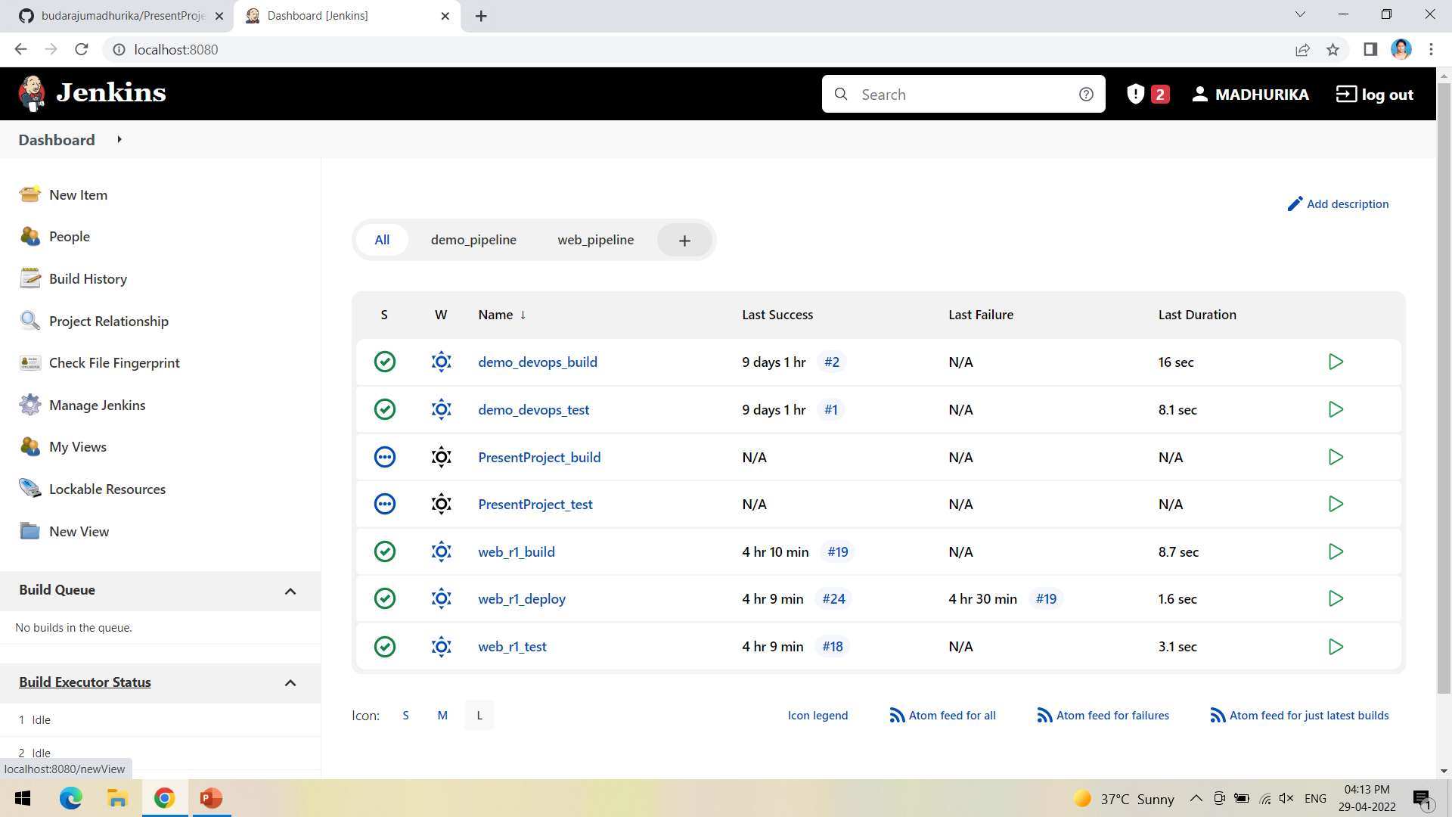
Create a pipeline by clicking on + symbol in the dashboard ->a pipeline is a collection of events or jobs which are interlinked with one another in a sequence

Slide 26
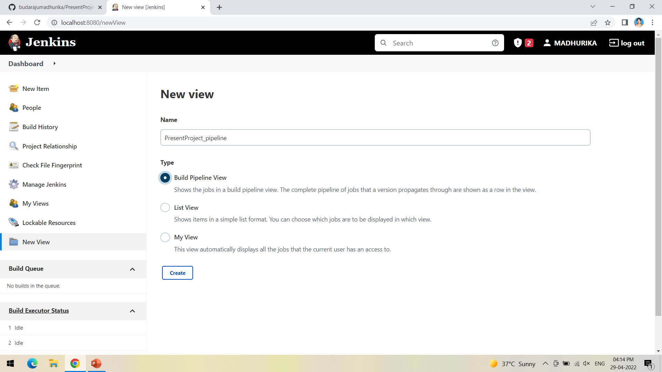
Give a name to the pipeline->select Build Pipeline View->create

Slide 27
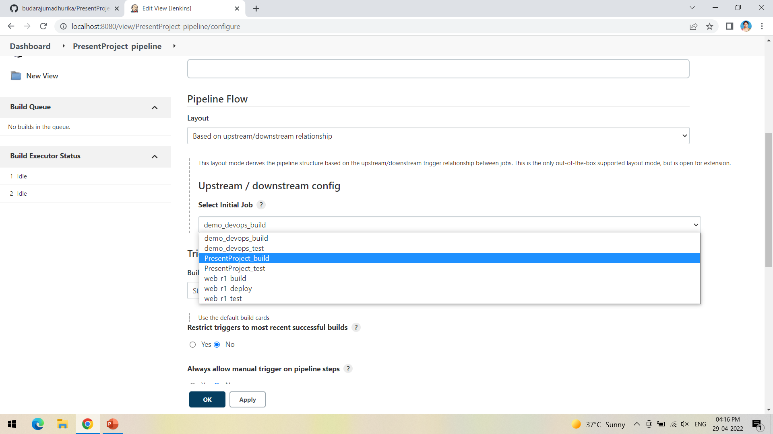
Select the first project to trigger the execution->build project

Slide 28
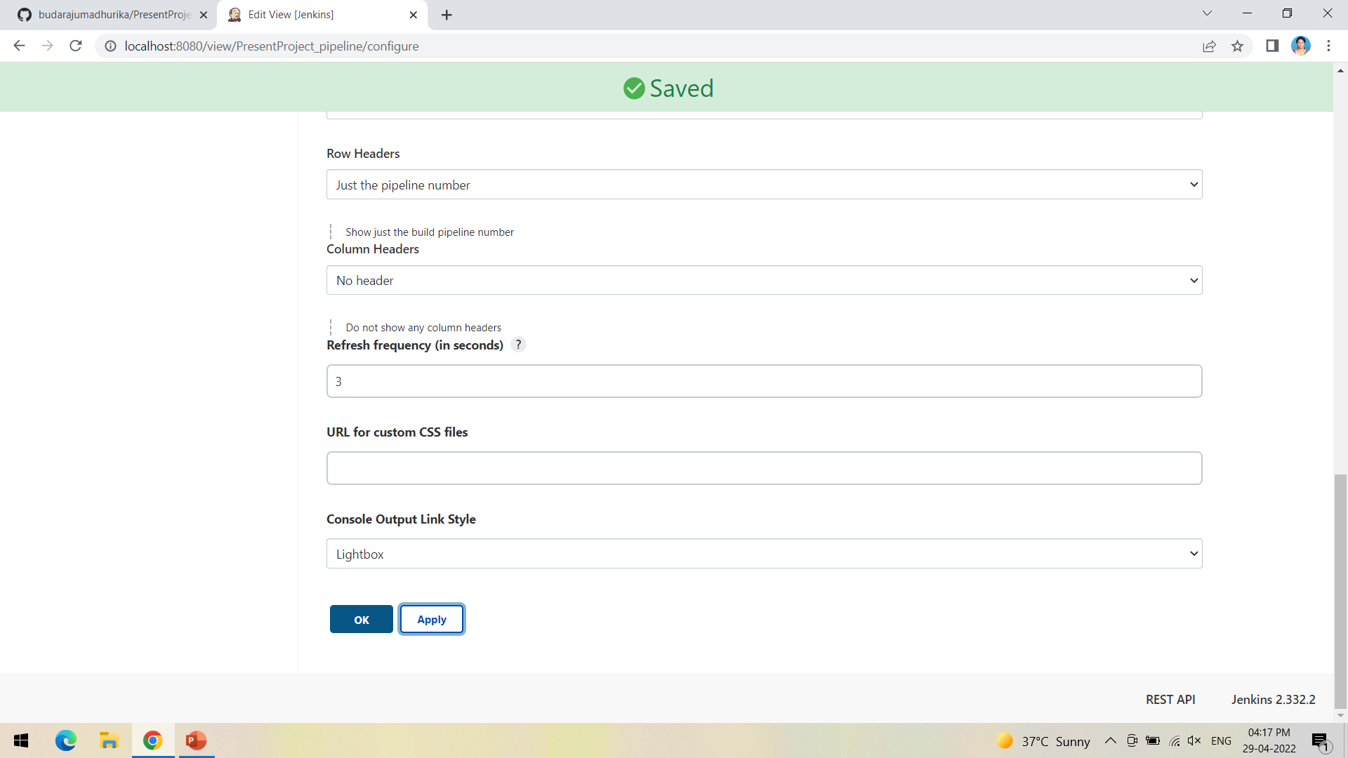
Apply->Ok

Slide 29
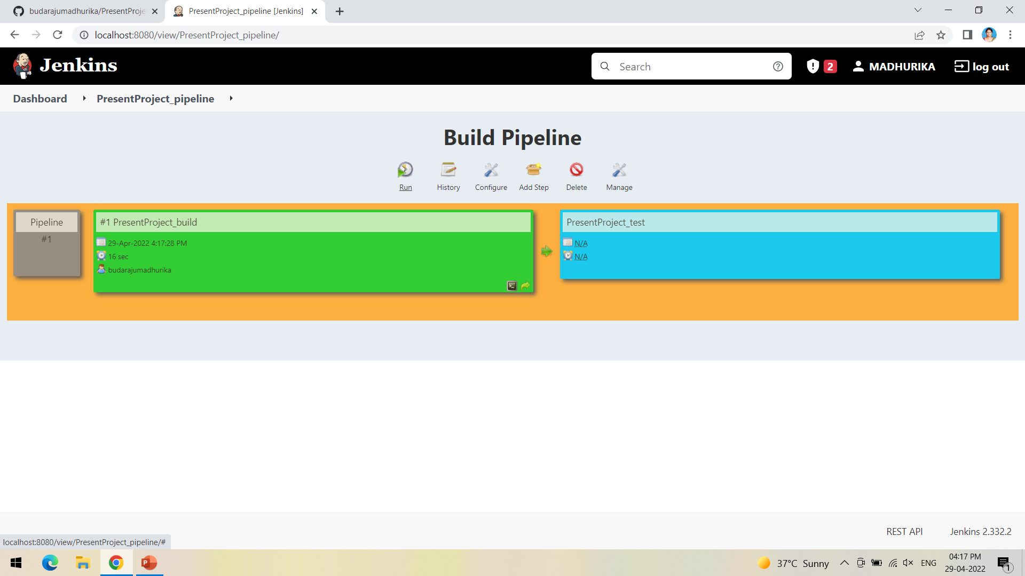
Click on Run -> click on the small black box to open the console to check if the build is success

Slide 30
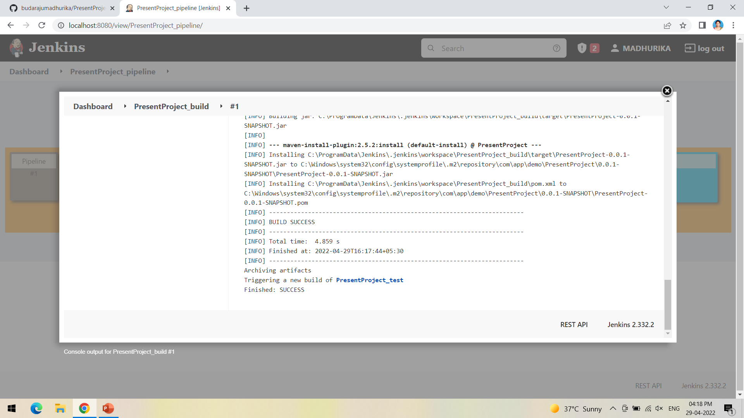
We can see that the build is success and the test project is also automatically triggered

Slide 31
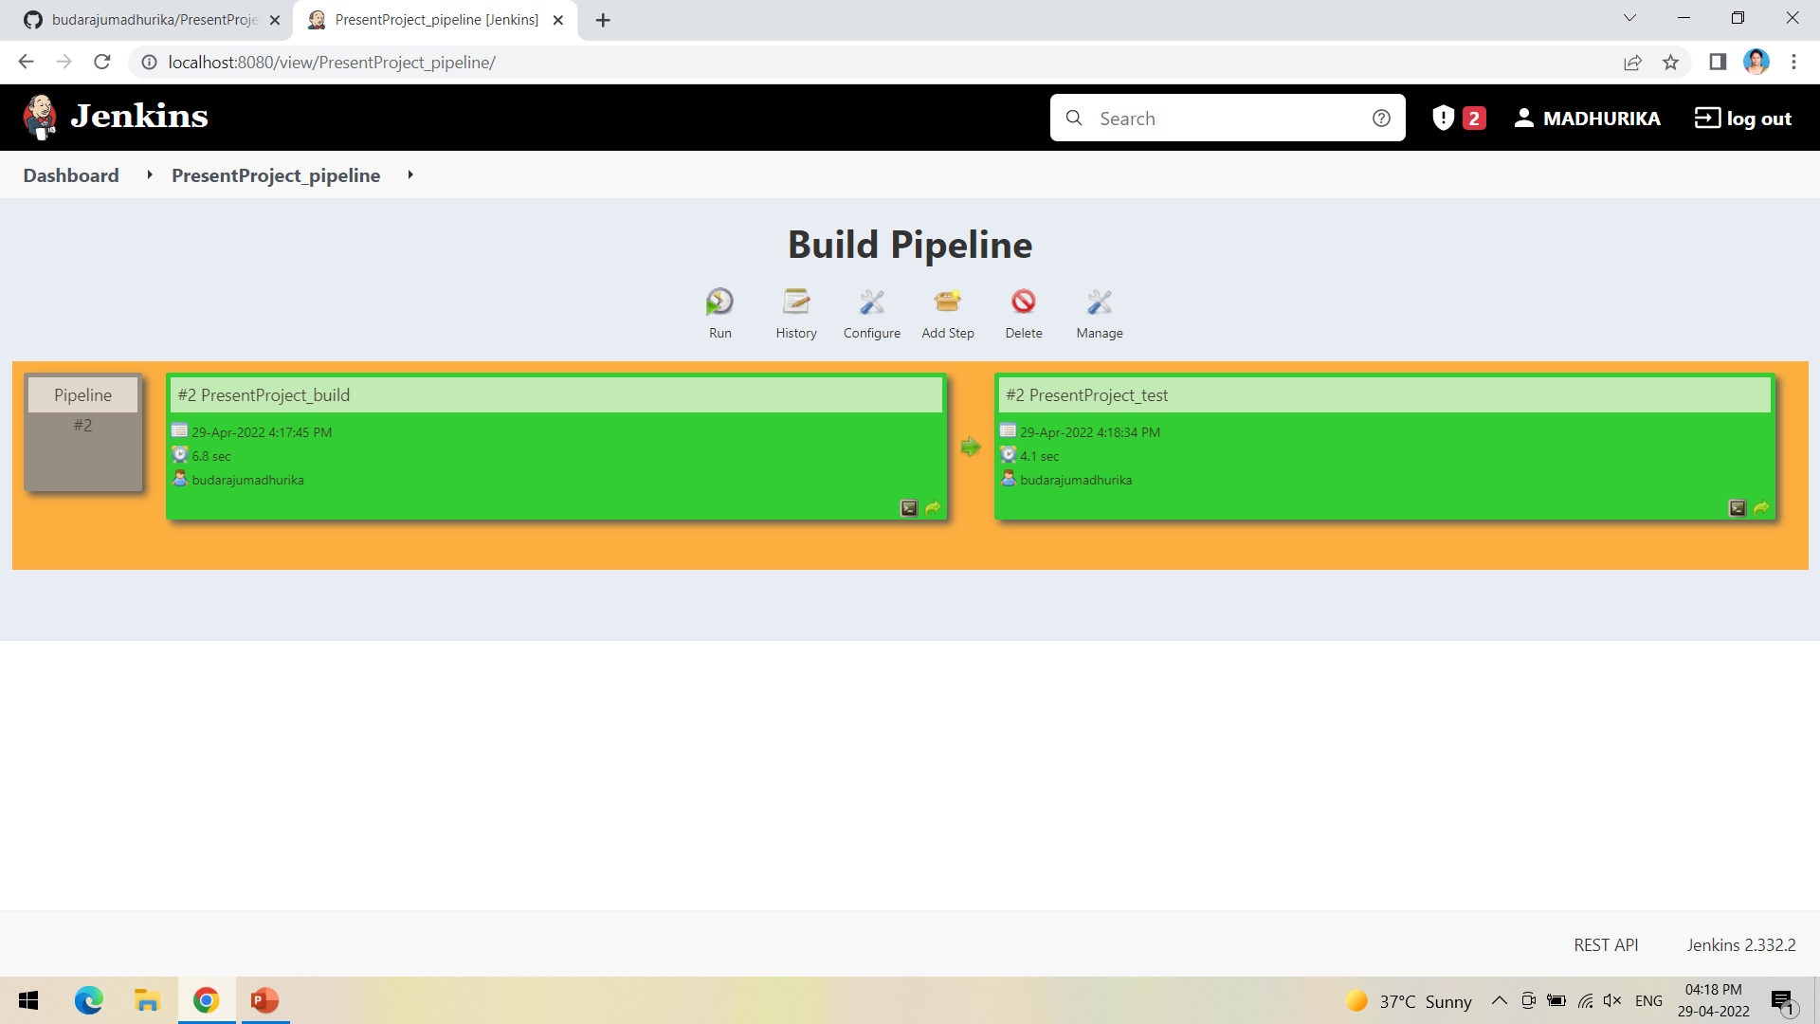
The pipeline is successful if it is in green color as shown ->check the console of the test project

Slide 32
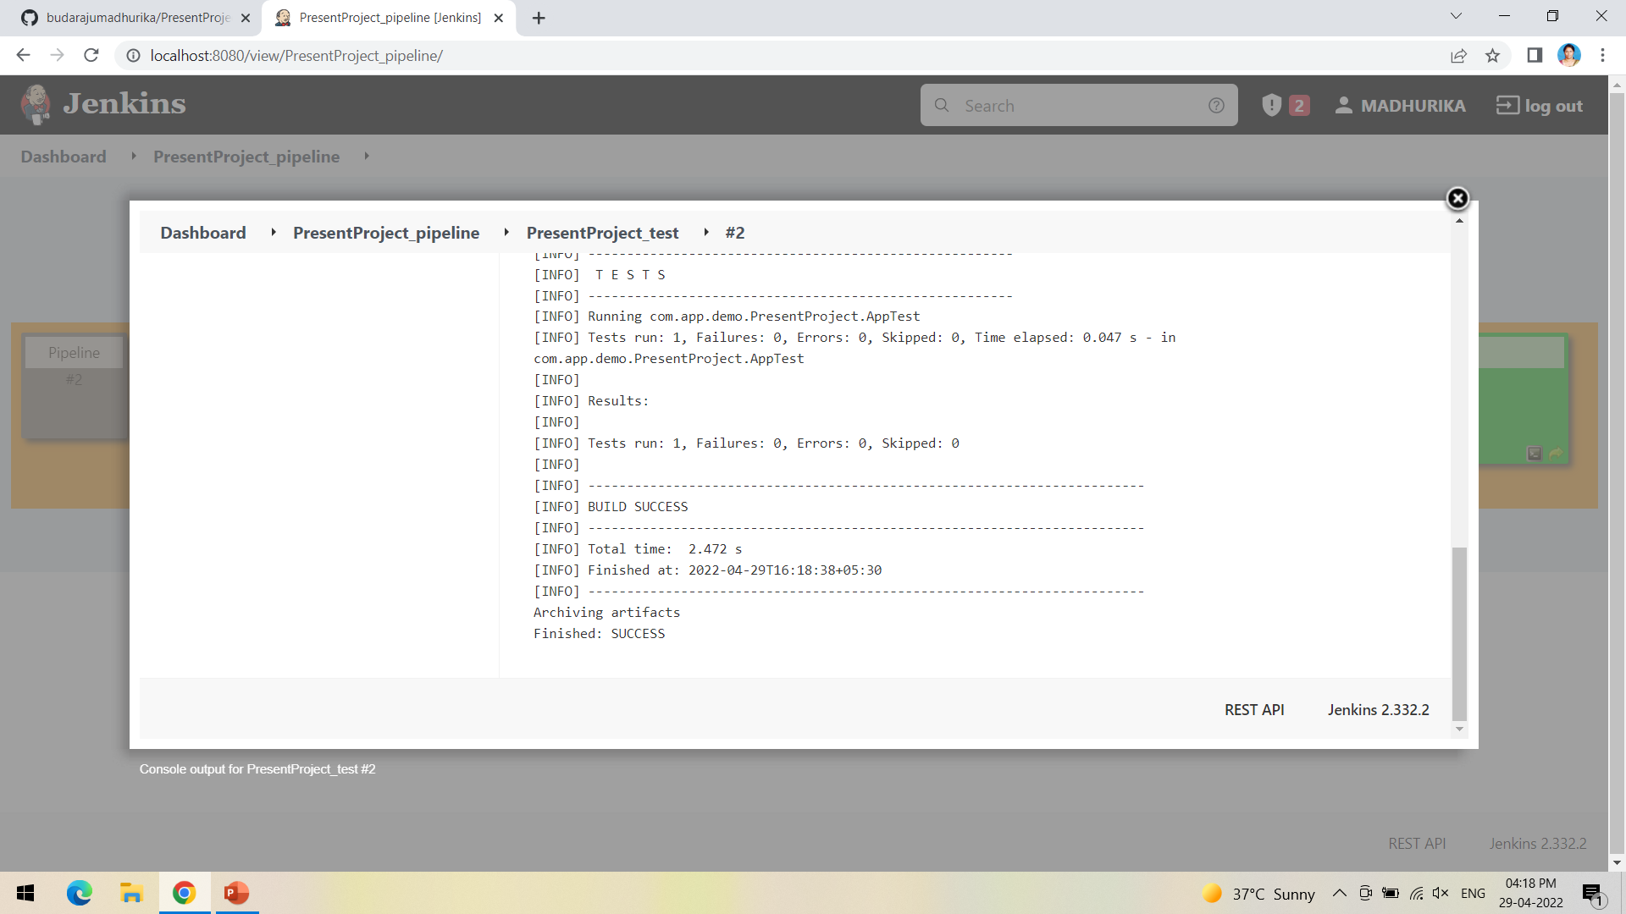
The test project is successful and all the artifacts are archived successfully

